Slide 1
ECG spectrogram scalogram

Slide 2
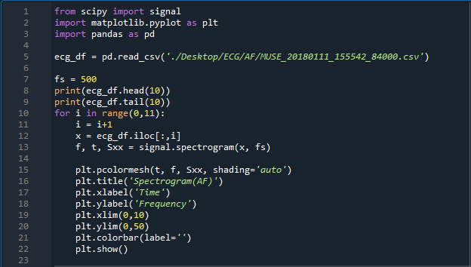
ECG spectrogram code

Slide 3
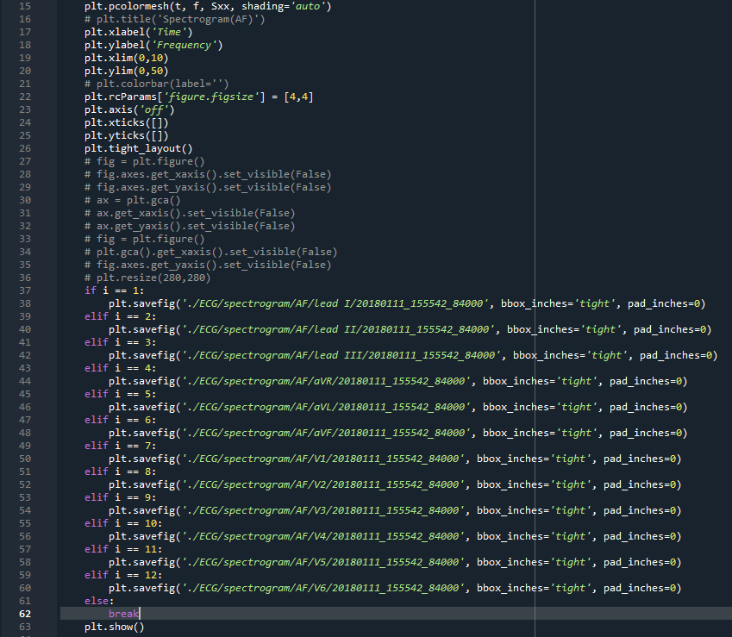
+ spectrogram code

Slide 4
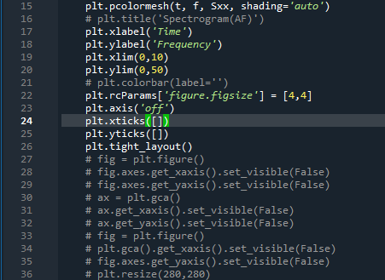
+ spectrogram code 설명
코드1

Slide 5
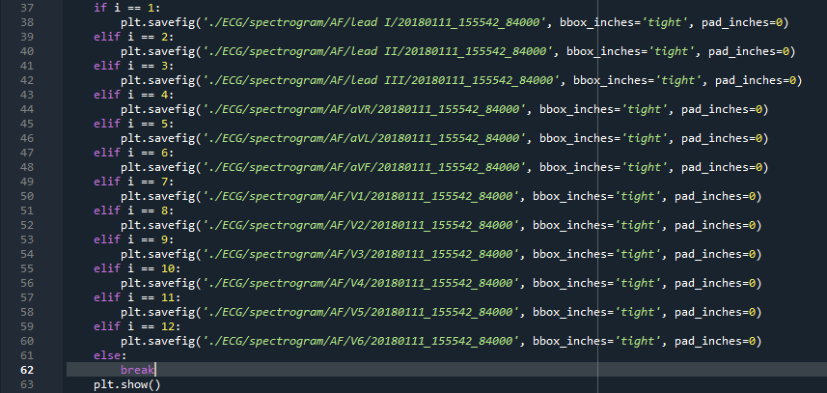
코드2

Slide 6


Spectrogram(AF)
Df 1열(lead I)
Df 12열(V6)

Slide 7
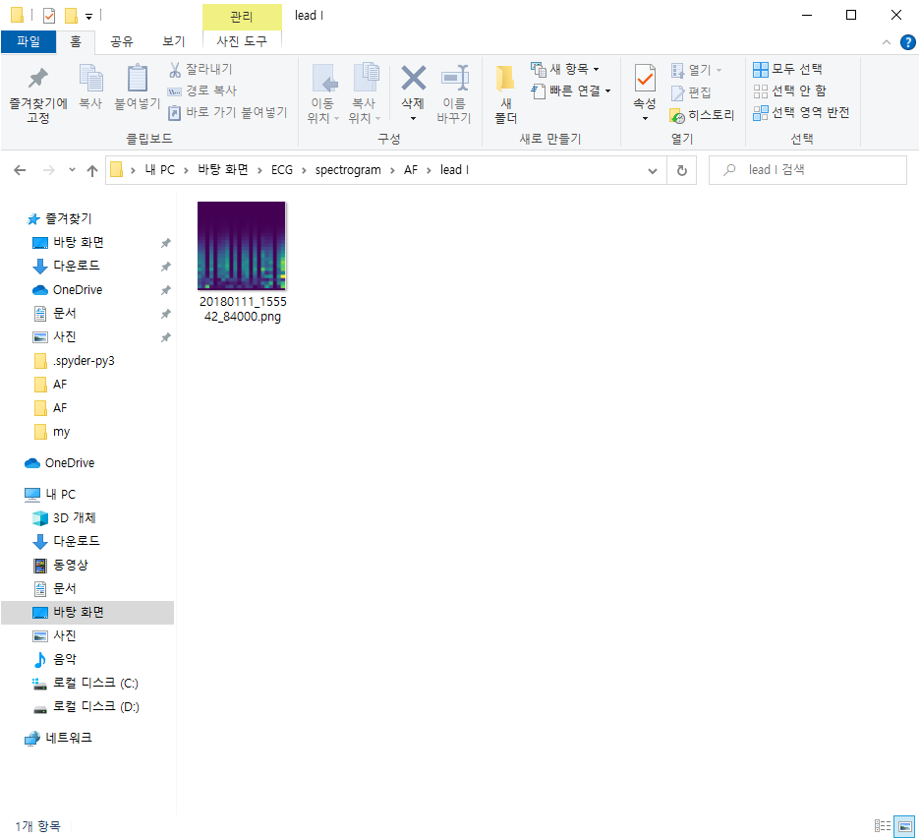
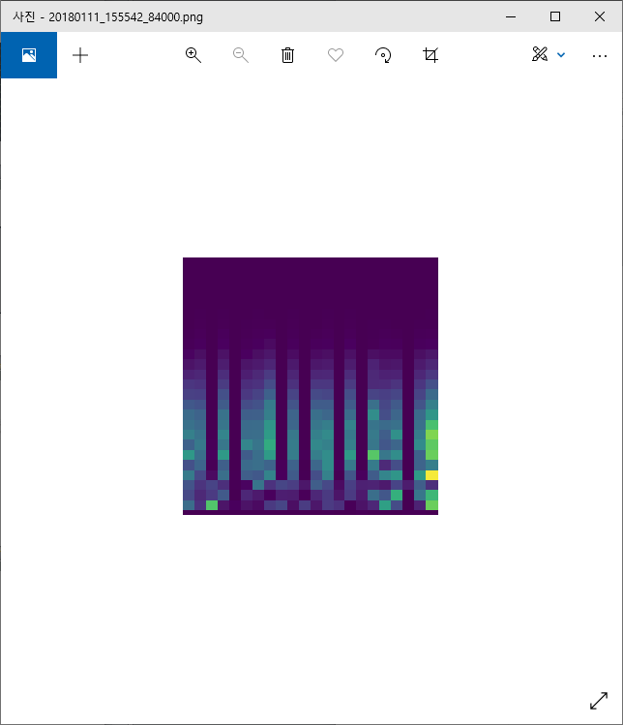

Slide 8
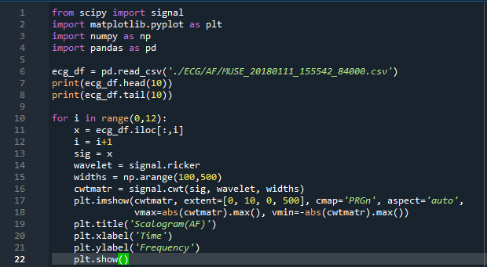
ECG scalogram code

Slide 9
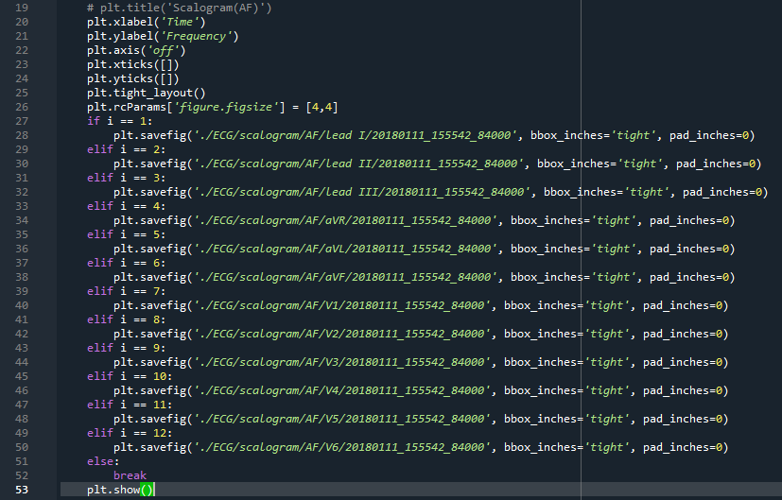
+ scalogram code

Slide 10
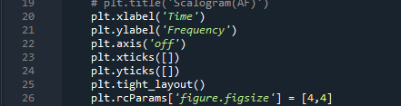
+ scalogram code 설명
코드1

Slide 11
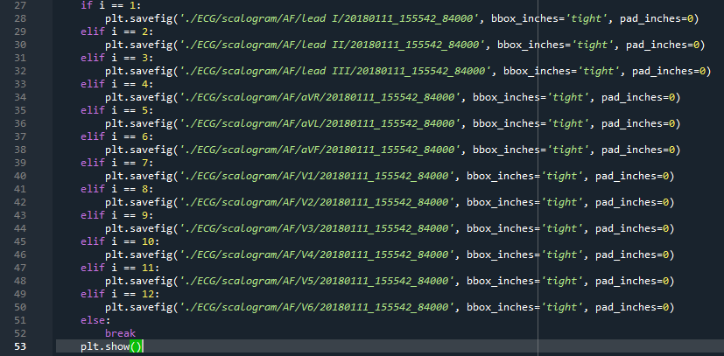
코드2

Slide 12


Scalogram(AF)
Df 1열(lead I)
Df 12열(V6)

Slide 13
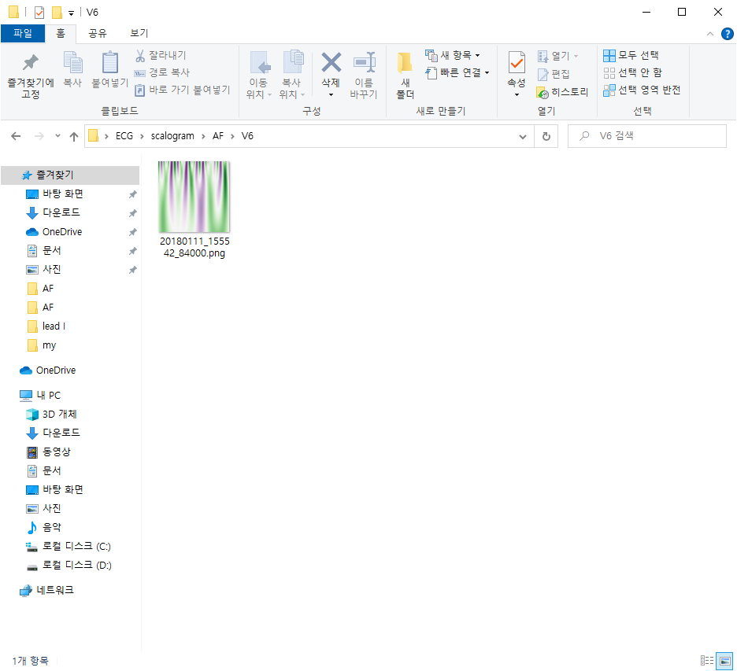


Slide 14
감사합니다

